Slide 1
Introduction to Supercomputing Center &
Quick Start Guide
Super Computing Center@USTC
Shen Yu
2016/10/11

Slide 2
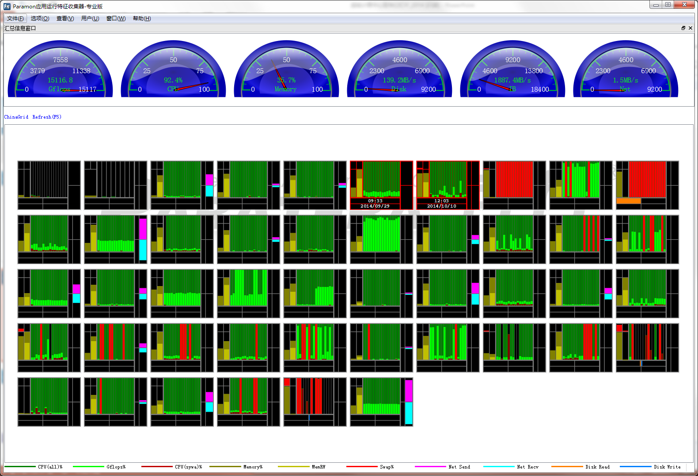
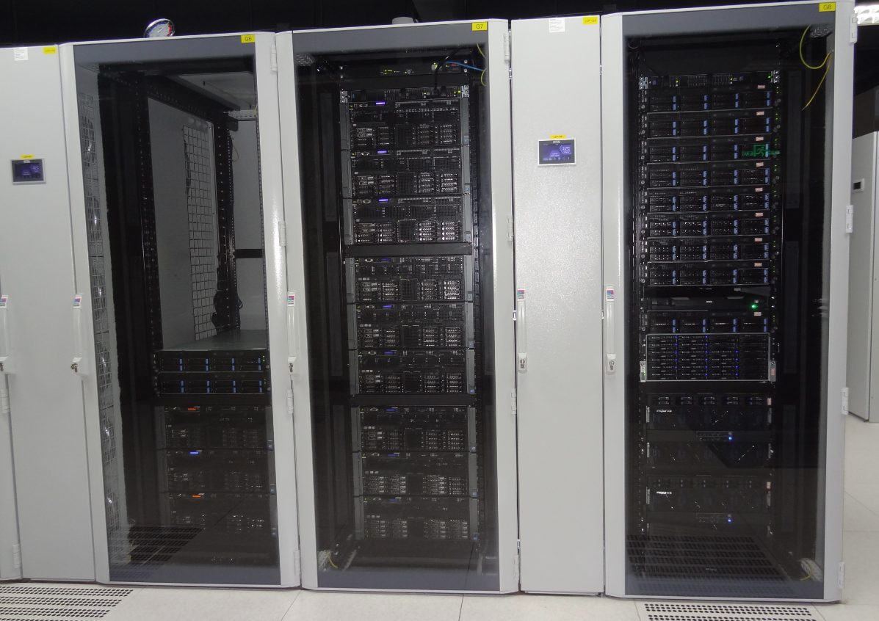
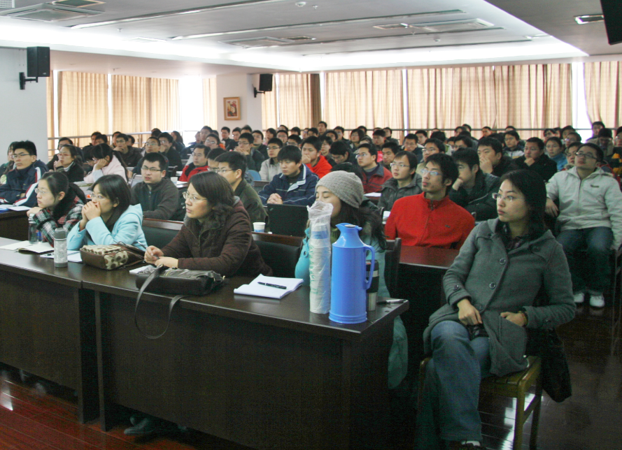
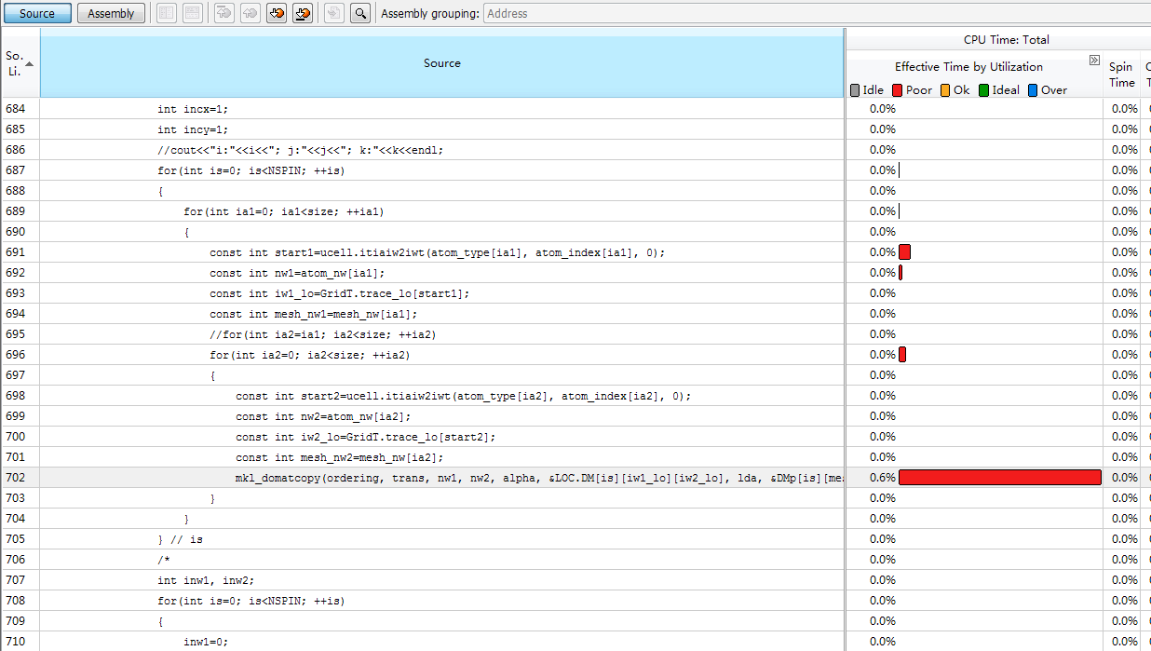
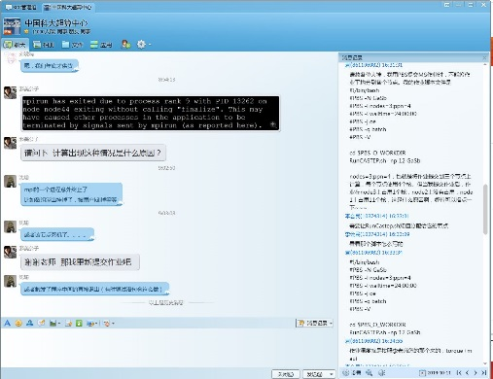
Service
Supercomputing Servers
Program Optimization
Server Hosting
Training & Supporting

Slide 3
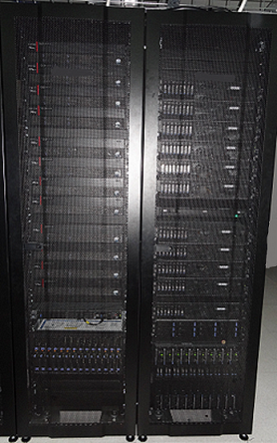
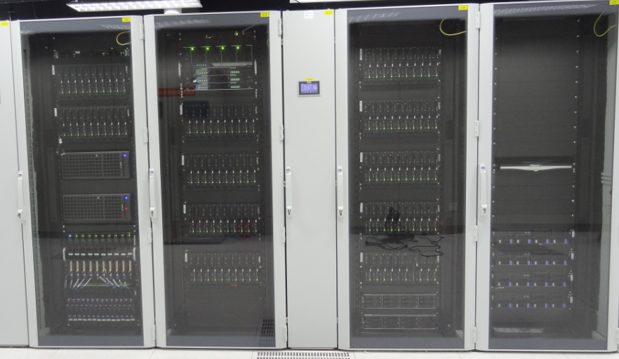
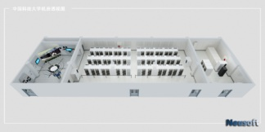

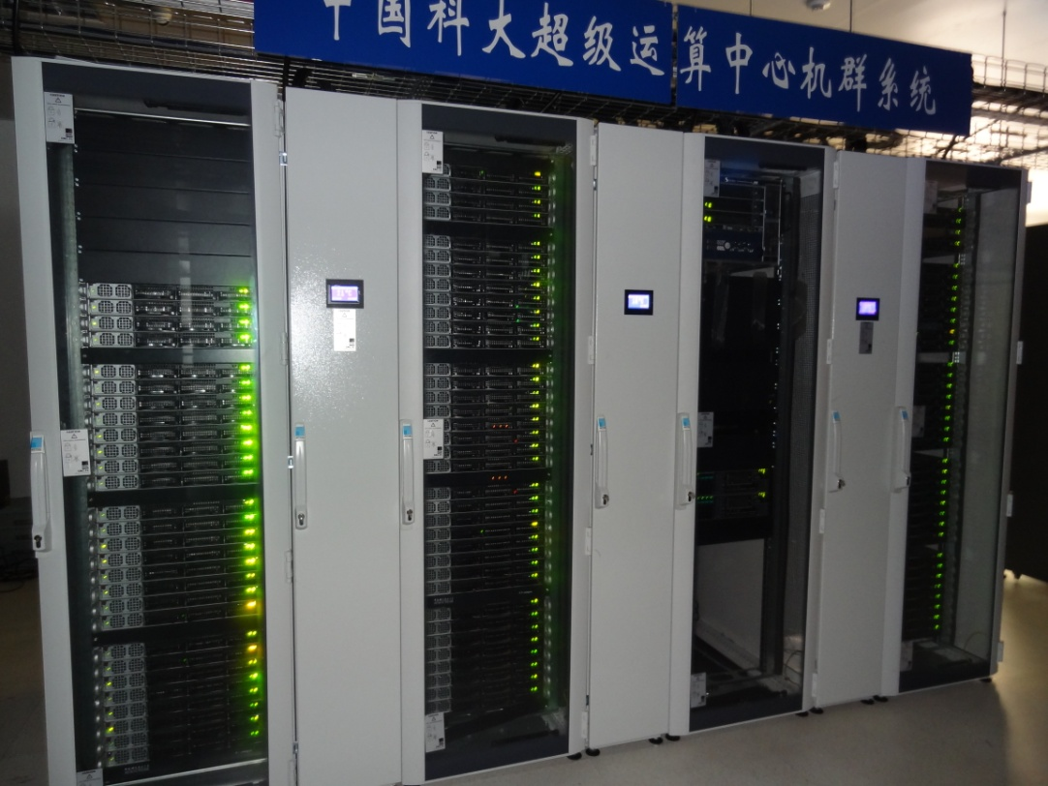
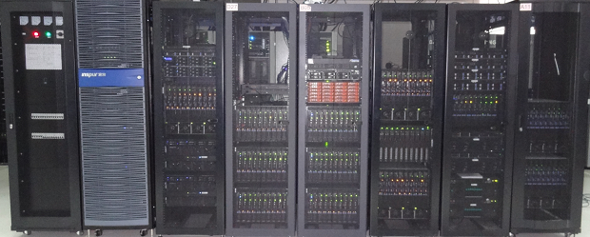
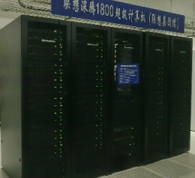
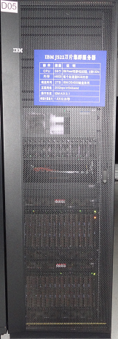
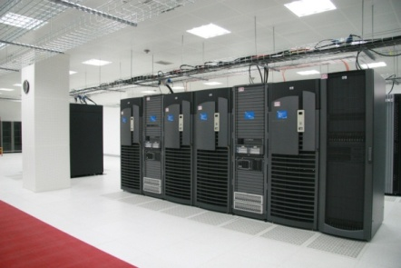
Timeline
2003.10 HP Superdome 1TFLOPS; 8 millions RMB
2011-2012, Blade & Fat Node Server, 15.46TFLOPS, 4 millions RMB
2013, ChinaGrid Server, 14.64 TFLOPS, 1.6 millions RMB
2013, New server room, 11 millions RMB
2008: 50th anniversary , Lenovo’s present，4.7 TFLOPS，2 millions RMB
2012, USTC sub-center of National supercomputing center in Tianjin; couputing cloud and big data process platform and storage cloud(45 nodes and 532T) 1.8 millions RMB
2014, Sugon TC4600 100TFLOPS System, 105TFLOPS, 6.23 millions RMB
Hefei sub-center of CAS supercomputing environment
2015, TC4600 upgrade to 202TFLOPS
2008: IBM JS22 Blade Server，1.8 TFLOPS，2.2 millions RMB
2010: Lenovo 7000G GPU Server, CPU:7.2TFLOPS，GPU: 200TFLOPS, GPU Center of CAS Supercomputing environment，5 millions RMB

Slide 4
3-level framework
Leasing Supercomputing resources from others
（Supercomputing Center of CAS
Shanghai Supercomputing Center
National Supercomputing Centers）
> 10000 CPU Cores
1000~10000 CPU Cores
Lab level Systems
< 1000 CPU Cores
SuperComputing Center@USTC

Slide 5
Supercomputing Platforms
555 TFLOPS
CPU：328 TFLOPS
GPU：222 TFLOPS
MIC：5 TFLOPS
ChinaGrid HIGH PERFORMANCE SYSTEM
BLADE & FAT NODE SYSTEM
LENOVO 7000G GPU SYSTEM
Sugon TC4600 100GFLOPS SYSTEM

Slide 6
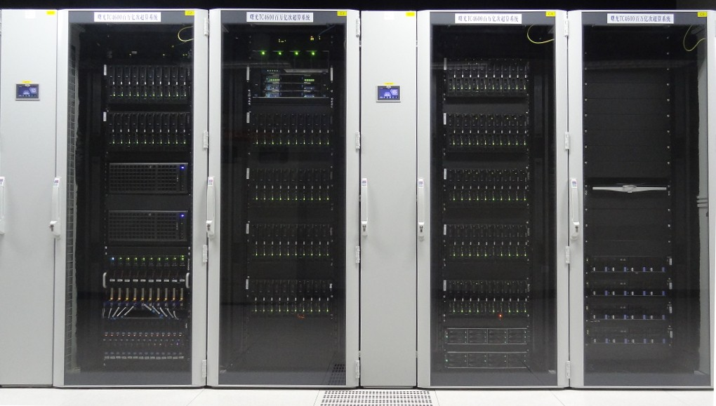
TC4600
307
Servers
300 Sugon TC4600V2 blades computing nodes
288 TFLOPS，7200 CPU Cores
Every computing node：
102TB Lustre parallel file system
56Gbps FDR InfiniBand Computing network
216 ports and 108 ports InfiniBand switches
5 IO servers
2 login and administrating servers
2 Intel Xeon E5-2680v3 12 cores CPU, total 24 CPU cores
64GB DDR4 ECC Memory
0.96 TFLOPS
Full speed connecting to all nodes
4 IO servers
1GBps File R/W speed
Large Scale MPI Parallel Applications, such as VASP, SIESTA, Fluent…

Slide 7
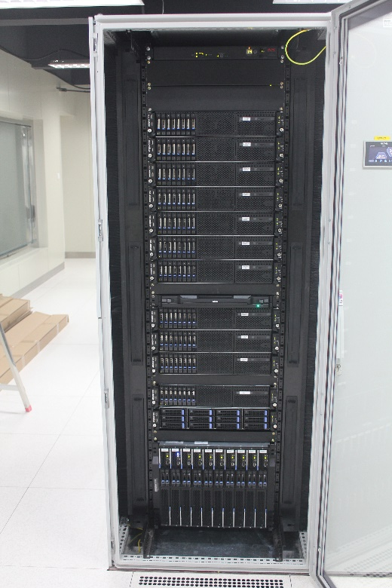
ChinaGrid
784 CPU Cores
1440GB Memory
2 MIC servers（7110P*2)
2 GPU servers（K40C*2）
56Gbps FDR InfiniBand
CPU: 17.23 TFLOPS
MIC: 5 TFLOOS
GPU: 5.6 TFLOPS
MPI Parallel Applications, such as VASP, SIESTA, Fluent, etc；
Studying or testing MIC, CUDA programming

Slide 8
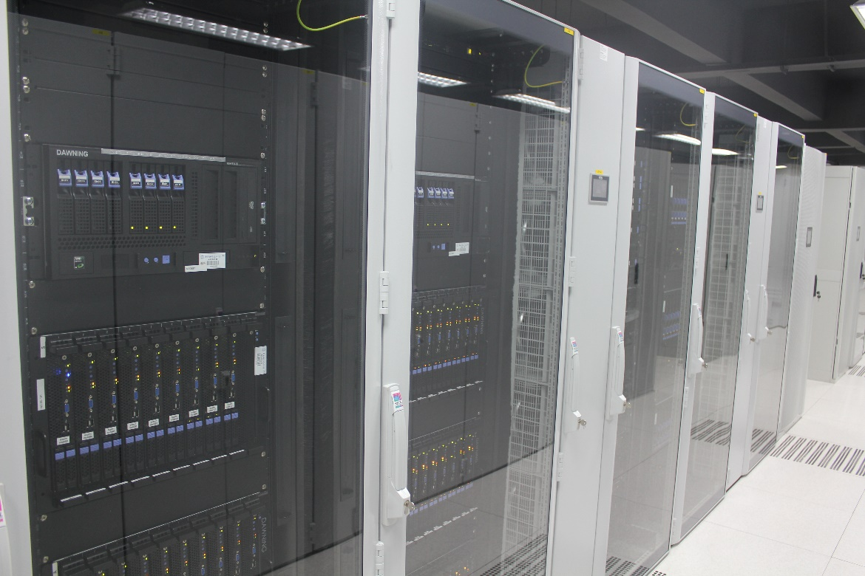
Blade and Fat Node
1528CPU Cores
3864GB memory
13TB Storage
12 fat nodes with multi CPU Cores and large memory capacity
15.46 TFLOPS
Small scale parallel application, such as MATLAB, VASP, SIESTA, etc.
Gaussian which needs multi CPU cores and large memory capacity

Slide 9
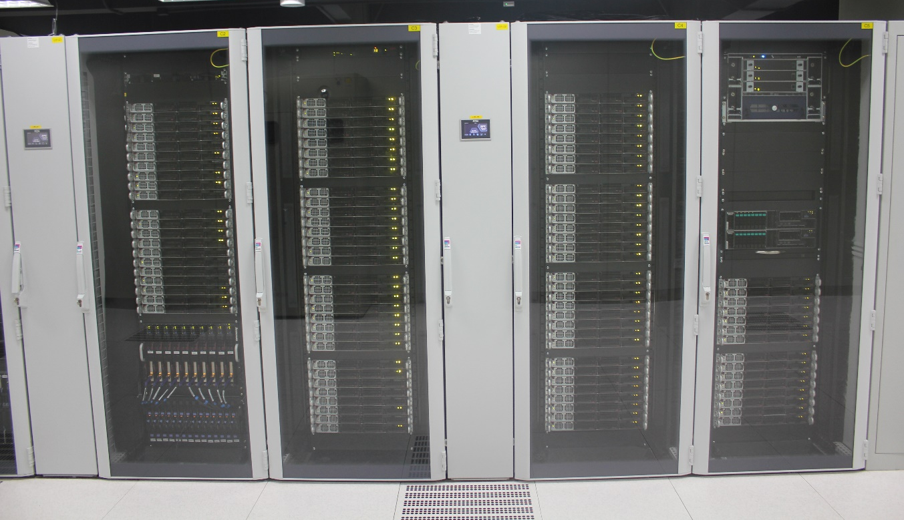
USTCGPU
800CPU Cores
1600GB Memory
72 GPU accelerate card
20Gbps InfiniBand
CPU:7.2 TFLOPS
GPU:216 TFLOPS
MPI Parallel & GPU Applications, Such as VASP, SIESTA, Fluent

Slide 10
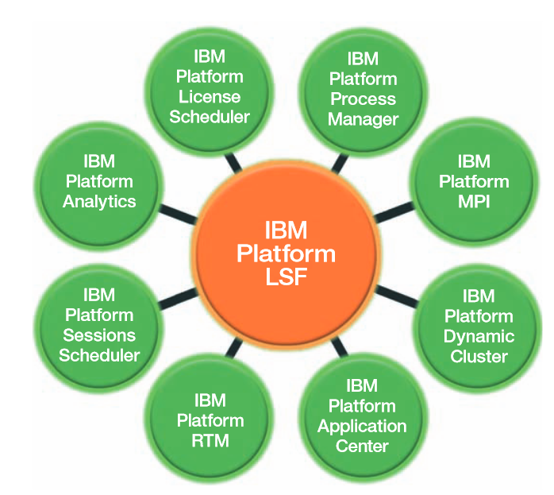
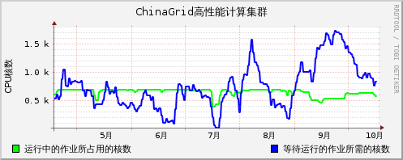
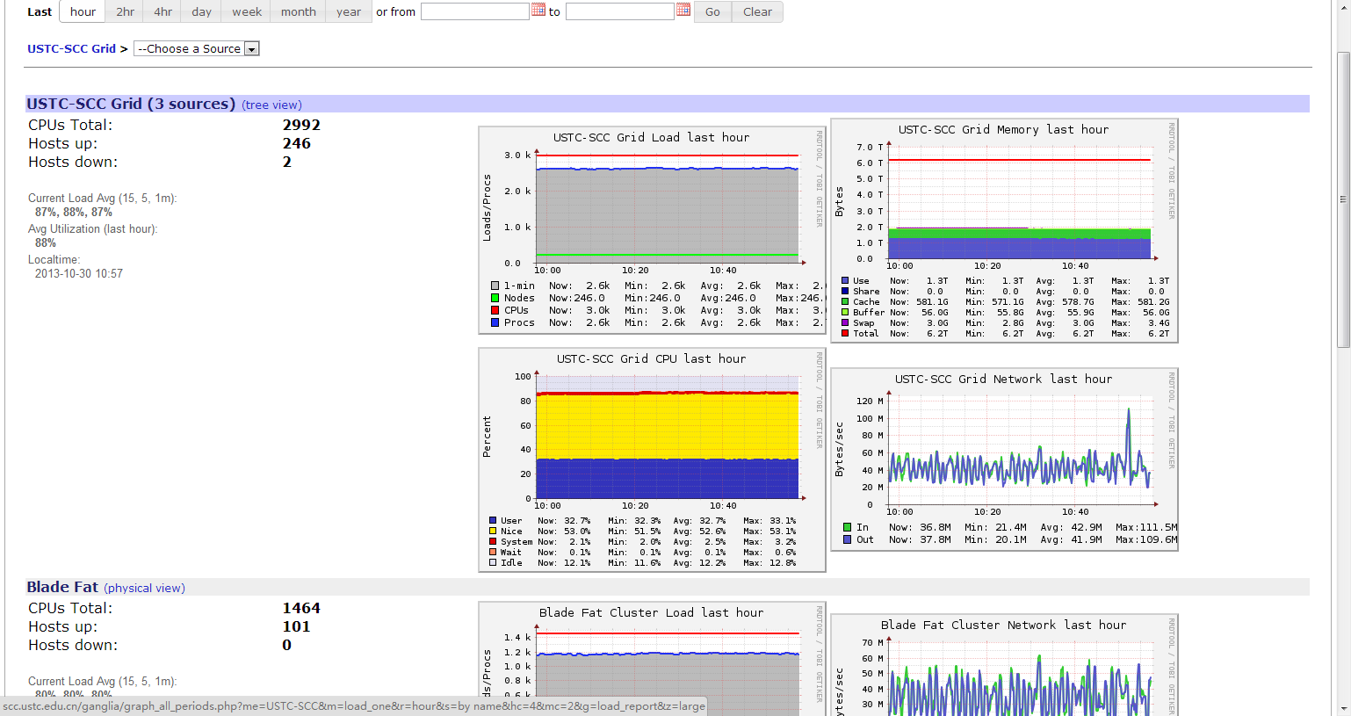
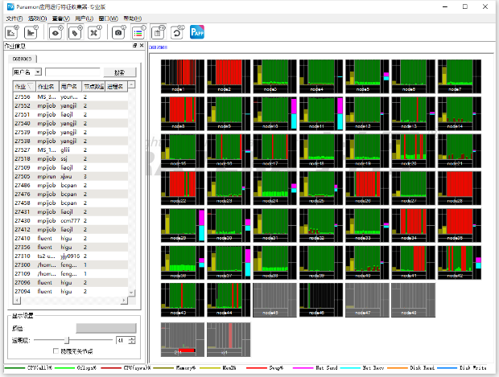
Manage & Monitor System
IBM Platform LSF
Job Manage System
Realtime job statistic system developed by Huimin Li
Open Source Ganglia
distributed monitoring system
Paramon Application Runtime
Characterization Collector,
provided by Paratera
Notes:
从左到右，从上到下分别是：
IBM LSF作业调度系统
自编网页监控
开源的Ganglia集群监控
并行科技的paramon系统监控

Slide 11












Professional Applications

Slide 12
User Achievements
Supported publicaions: 563
2013: more than 100 publicaions for the first time in a year
超算中心主页➔成果展示➔支持用户发表的论文
http://scc.ustc.edu.cn/cgzs/201511/t20151122_230888.html

Slide 13


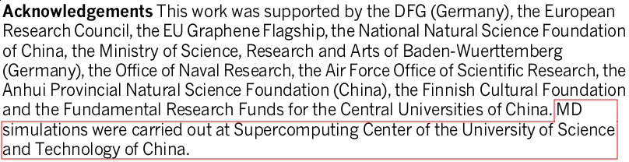
Recent Major Achievements
Square ice in graphene nanocapillaries
(Nature, 519 (7544): 443-445, 2015)

Slide 14

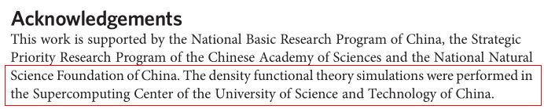
Recent Major Achievements
Distinguishing adjacent molecules on a surface using plasmon-enhanced Raman scattering
Nature Nanotechnology，2015
Prof. Jinlong Yang

Slide 15
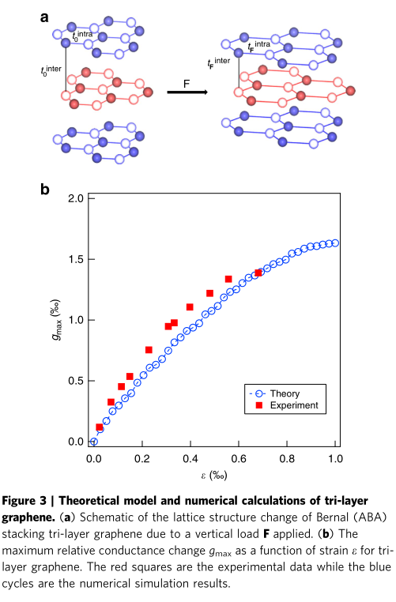
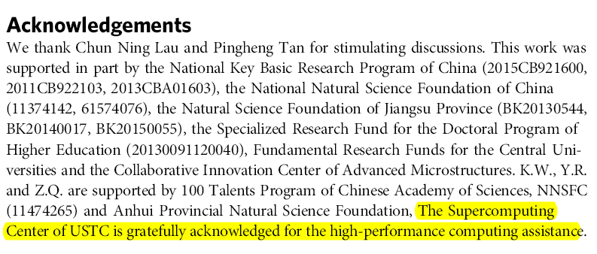
Recent Major Achievements
The positive piezoconductive effect in graphene
（DOI: 10.1038/ncomms9119）
  Nature Communication, 2015
  Prof. Zhenhua Qiao

Slide 16
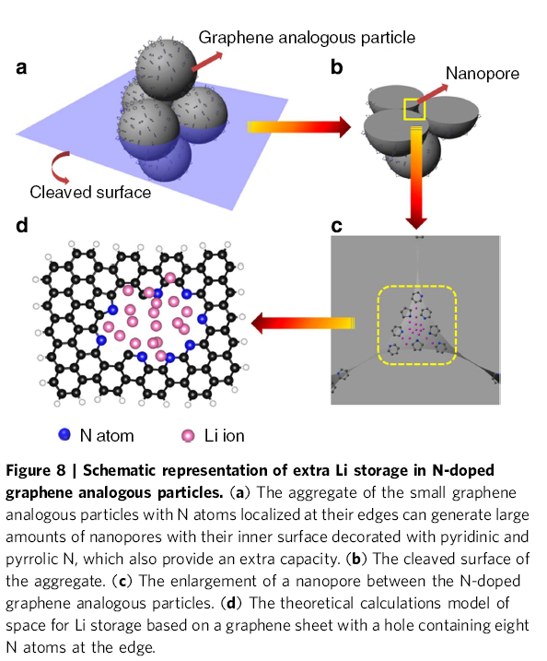
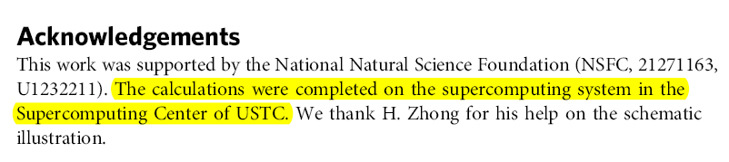
Recent Major Achievements
High lithium anodic performance of highly nitrogen-doped porous carbon prepared from a metal-organic framework
（DOI: 10.1038/ncomms6261）
  Nature Communication，2014
  Prof. Qianwang Chen

Slide 17

Large-scale Application
Dark matter movements under the influence of gravitational force
Application: L-Gadget2
1024 CPU cores

Slide 18
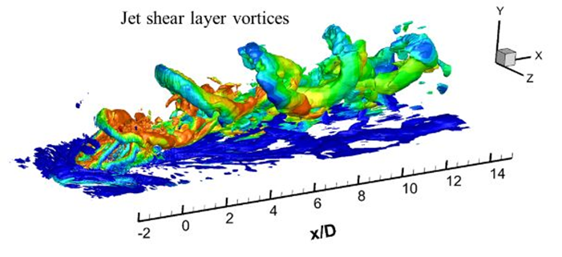
Large-scale Application
Combustion process in a scramjet combustor
Application: OpenFOAM
960 CPU cores

Slide 19


Large-scale Application
Formation of Shear Bands in copper nanowire of 128 million Cu atoms
Application: Lammps
1536 CPU Cores

Slide 20
Large-scale Application
Study of structure of DNA chains containing 250 000 atoms
Application: Gromacs
1440 CPU cores

Slide 21
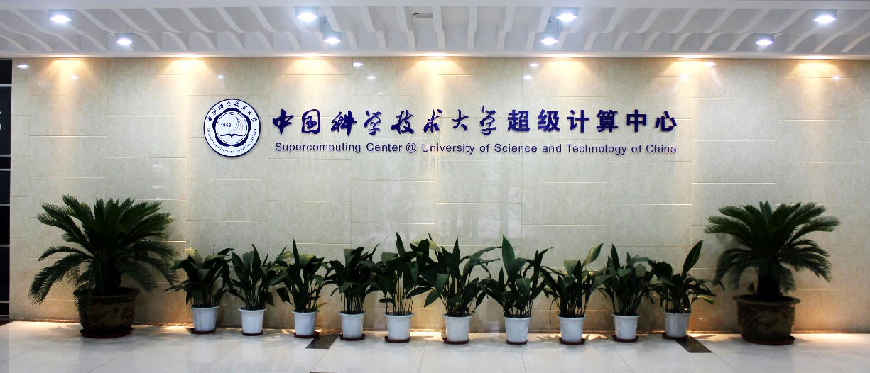
Director:
Li jing(lj@ustc.edu.cn)
Deputy director:
Li Huimin(hmli@ustc.edu.cn)
System and user administration & technique support:
Zhang Yundong(zhangzyd@ustc.edu.cn)
Technique support & application development:
Shen Yu(shenyu@ustc.edu.cn)
Zhang Wenshuai(wszhang@ustc.edu.cn)
Tel.: 0551-63602248
Email: sccadmin@ustc.edu.cn
Homepage: http://scc.ustc.edu.cn
Address: Room 126, new library building, east campus, USTC

Slide 22
Please Support Us
Users:
University
Supercomputing Center
Response to our survey
Put SCC in your publications
Buy more servers
SCC plays an important role in researching/teaching ➔ Give SCC more support
Provide better service

Slide 23
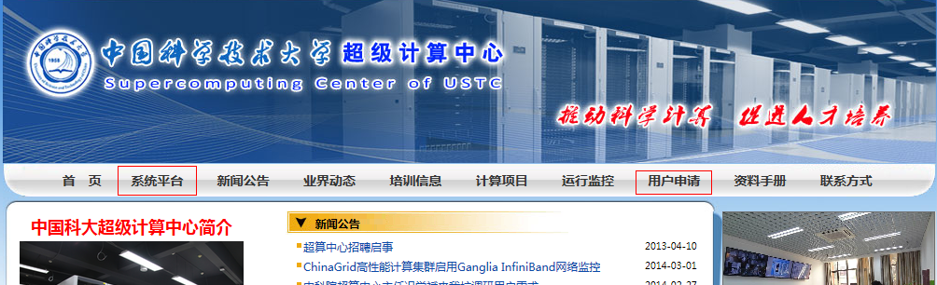
The Quick Start
Start from our website: http://scc.ustc.edu.cn
Apply for an account
Login our server
Use server: linux
Use server: editor
Use server: submit jobs
Use server: applications
Use server: manager jobs
VPN: visit outside campus
Use server: compiling

Slide 24
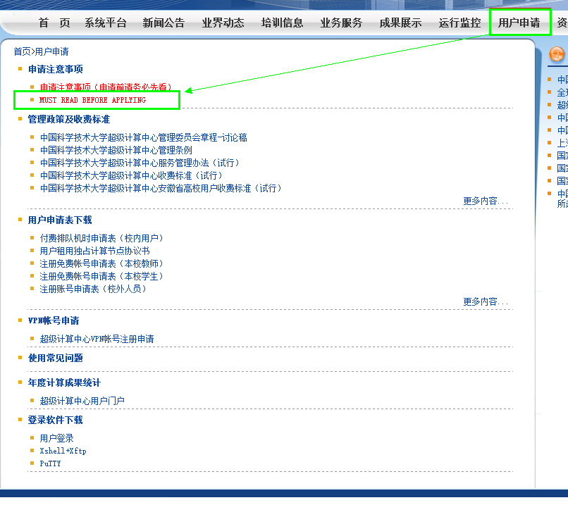
Normal Account Application
Read “MUST READ BEFORE APPLYING”
Send an email to sccadmin@ustc.edu.cn and ask for an application form
Fill the form and send to sccadmin@ustc.edu.cn, remember forward to your supervisor
Note:
Ask your supervisor and get his/her permission. Forward the application email to your supervisor.
Change your password when you first login, and be sure to use a complex one
Do NOT tell your password to anyone including administrators
Please tell us your scientific achievements and put SCC in the acknowledgment of your papers

Slide 25
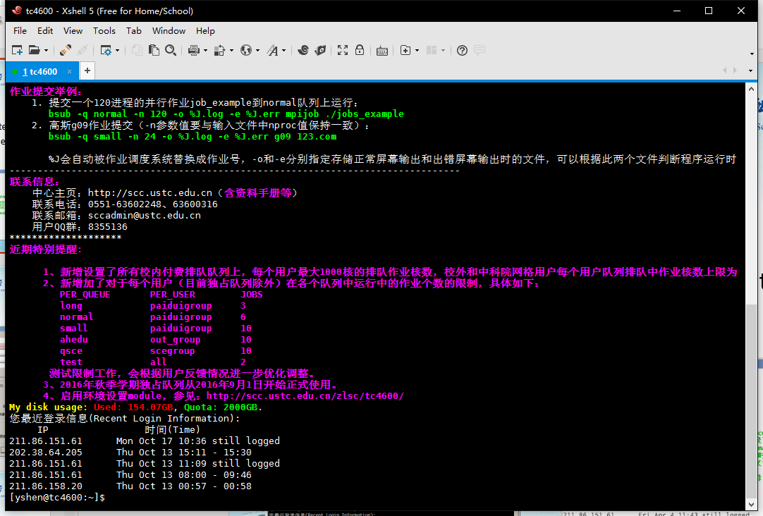
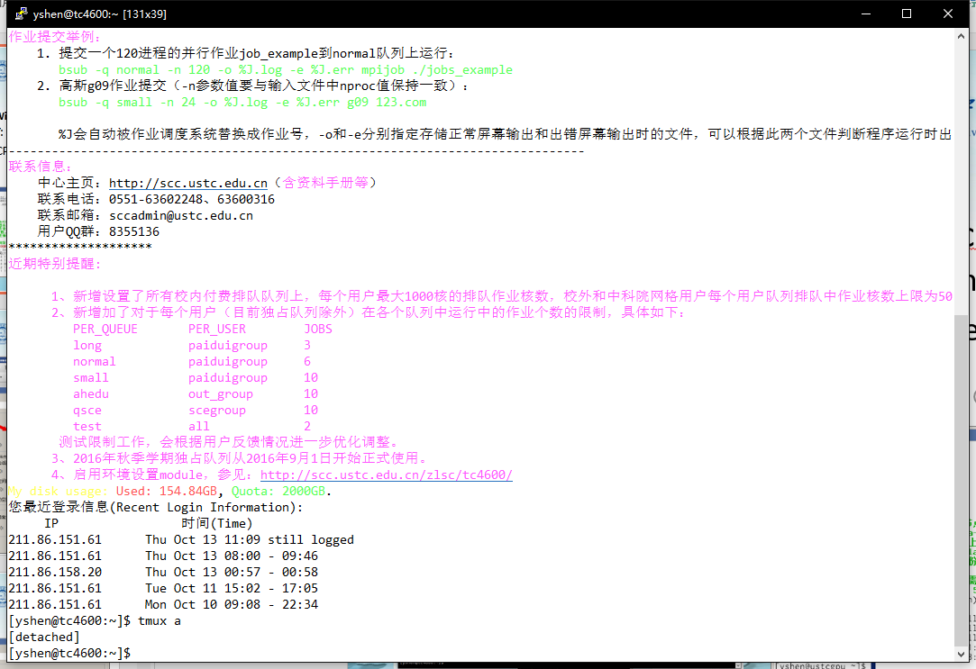
Software to Login
XShell+XFTP
PuTTY+WinSCP
Better user interface
Multi-tab: good for more than one servers
PuTTY: Simple interface
WinSCP: remote editor

Slide 26
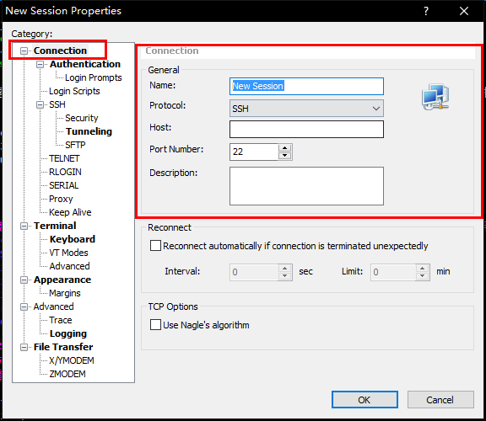
Xshell Setting： server
Name: given by yourself
Protocol: SSH
Host: IP address give in the account information email
Port Number: 22

Slide 27
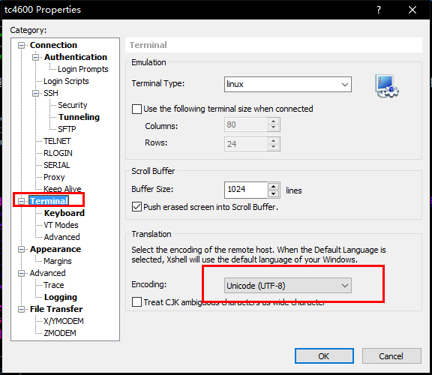
Xshell Setting：encoding
UTF-8 is used in our servers
Check it if you find there are messy code on your screen.

Slide 28
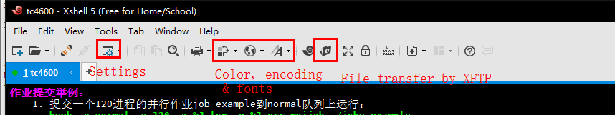
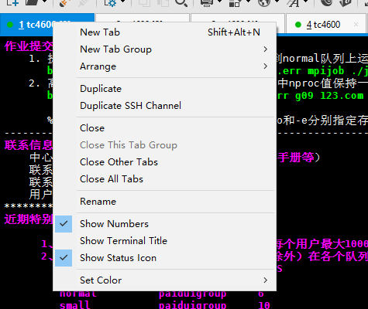
Xshell: Tools & Multi-tab

Slide 29
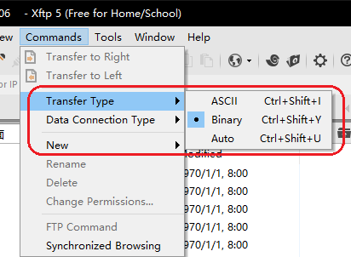
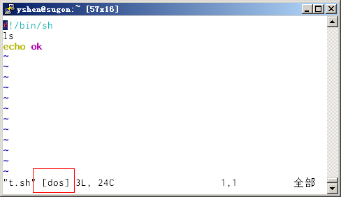
XFTP: file transfer
Note: Transfer Type
  Binary: data, compressed file …
  ACSII: program source file …
  Why ASCII and Binary?
  Binary: byte to byte upload/download
  ASCII: make change at new line
  Windows: \n\r
  Linux/Unix: \n
  Incorrect new line may cause script running error

Slide 30
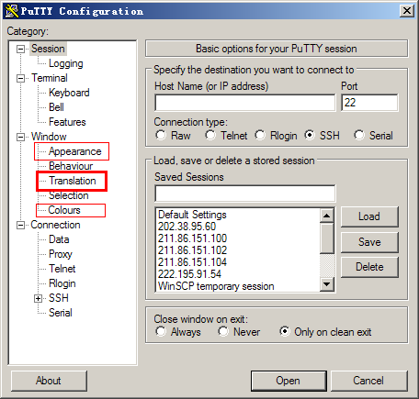
PuTTY Setting: server
Setting interface

Slide 31
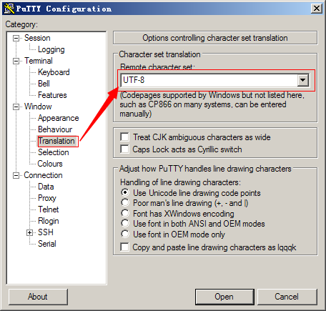
PuTTY Setting: encoding

Slide 32
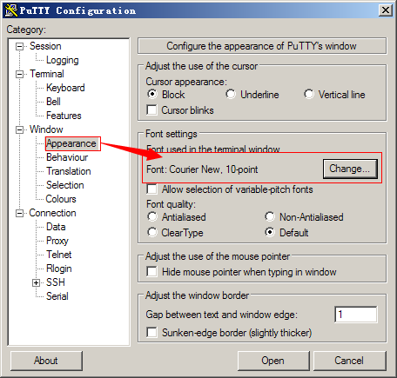
PuTTY Setting: Font

Slide 33
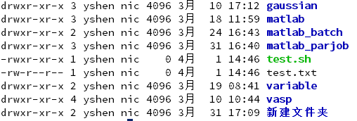
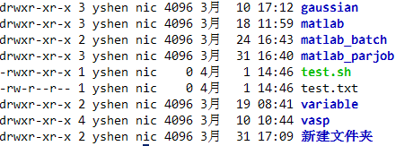
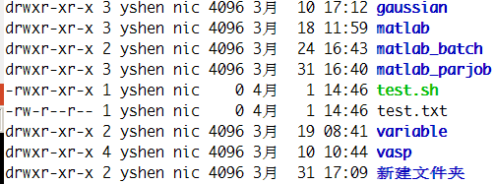
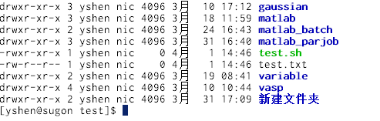
PLUS:
How to choose a GOOD font
Monospaced font: good for programming
Easy to distinguish 0,O; I,l,1
Source Code Pro
Consolas
Monaco
Inconsolata

Slide 34
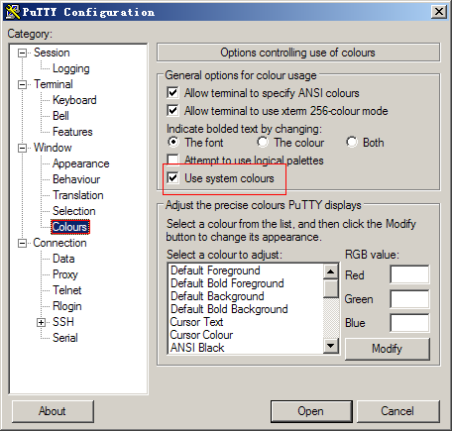
PuTTY Setting: color

Slide 35
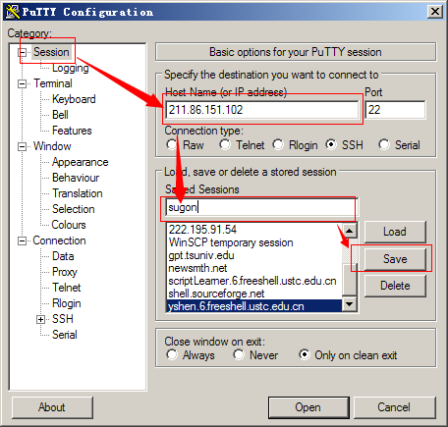
PuTTY Setting: save & load

Slide 36
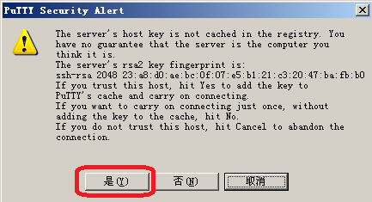
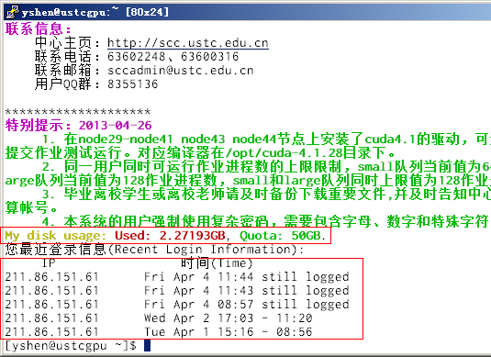
PuTTY: first login
Check host key when first login
Password will not be shown when you input
Information is important
Check disk space
Check recent login IP
Read the login information again:
cat /etc/motd

Slide 37

PuTTY:
Where’s the Menu
PuTTY will forward all keyboard instructions to remote server directly
Click the up left corner to show the menu

Slide 38
Note: Account Security
Change your password regularly
Do NOT use weak password
  Hack crack regular account ==> obtain root privilege by system vulnerability
  What is weak password: short, date(birthday, anniversary,...), words, password with username, pure numbers, pure letters, letters with order
  examples: 123456, 19910901, hello, tom123 (suppose username is tom), asdfg, 1qaz2wsx
A easy way to create a GOOD password
  Use the first(second, third, ... ) letter of each word in a sentence:
  Mmdmttawtwrd My mother drove me to the airport with the windows rolled down
Use software to manager your passwords: keepass

Slide 39

WinSCP Setting: server
File protocol: SFTP/FTP
Hostname: IP address
Port number: 22
User name:
Password: (only remember it in your own computer)

Slide 40

WinSCP Setting: Editor
Edit remote file at your local computer
Use different editors for different file type
double click the remote file,
WinSCP will download and open it automatically, and upload to the server when you save it.

Slide 41
PLUS:
What is a GOOD editor
show the difference of unvisible symbols (space / tab, LF / CR+LF)
Highlights
automatically complete
code folding
support for proportional font
…

Slide 42

File Transfer
Text/Binary type
  Text: source files, scripts
  Binary: data, compressed files

Slide 43
Useful Linux Command
All servers use linux(CentOS) and only support command line interface.
Useful command:
  ls: list directory contents
  cd: change directory
  pwd: print the current working directory
  cat: print files on the standard output
  more: print files on the standard output page by page
  less: opposite of more
Useful tools:
  edtor: nano, vim
  compress: tar, gzip, bzip
Auto complete:
  Input the first letters and press TAB once or twice

Slide 44

Get Help
man: look up a command from the manual

Slide 45

Get detailed information: info

Slide 46
Environment Variables
Environment Variables: Variables everywhere
show all environment variables: env
set environment variables: export
important environment variables:
  PATH: where the running program locate
  LD_LIBRARY_PATH: where the dynamical library files locate
  OMP_NUM_THREADS: number of threads of OpenMP programs
  MKL_NUM_THREADS: number of threads of programs using Intel MKL
  EDITOR: default editor

Slide 47

File edit: Nano
A simple editor
Most command are shortcuts
get help by Ctrl+G

Slide 48

File edit: VIM
An powerful editor
multi-mode: normal mode/insert mode/visual mode/command mode
use vimtutor to learn vim: learn and practice

Slide 49
File edit: VIM
simple commands:
  i/a/o/O: enter insert mode at current position/next letter/next line/previous line
  h/j/k/l: move the cursor to left/up/down/right
  gg/G/0/$: move the cursor to file beginning/file end/line beginning/line end
  w/W/b/B: move the cursor forward/backword based on words
  x: cut
  p/P: paste at current/next position
complex commands: verb+object, may with numbers and other adverb
  examples:
    y$: copy content from current position to line end
    2dw: delete 2 words
    ci': change the content inside the quotation mark

Slide 50
File edit: VIM
File operation:
  :e filename edit a file
  :e directory open a directory
  :e! discard the unsaved changes recover the file to last saving state
  :w save the file
  :w filename save the file with the filename
  :q exit the file (if there are some unsaved changes, you will get a prompt)
  :q! discard unsaved changes and exit
Search/Replace:
  / ? * search command
  Replace a string at current line :s/xxx/yyy
  Replace all the strings at current line :s/xxx/yyy/g
  Replace the string all over the current file :%s/xxx/yyy/g
Auto complete
  press ctrl+p under insert mode

Slide 51
Compile Fortran Programs:
Intel FORTRAN
Single file program:
  ifort -O2 -o output_filename source_filename
  -O2: optimize level
  -o: set the output filename
multi-files program
  ifort -O2 -o output_filename source_filename1 source_filename2 ...
  write a makefile and use make command
OpenMP parallel program
  ifort -O2 -openmp -o output_filename source_filename(s)
  add -openmp parameter
MPI parallel program
  mpiifort -O2 -o output_filename source_filename(s)
  use mpiifort instead of ifort

Slide 52
How to Run a Program
use 'bsub' to run the program instead of running it directly
log file is always important: %J.log %J.err
read the login information for instructions and examples or use cat /etc/motd to read it again after login
use 'bqueues' command to show all queues
Note:
the directly running program may be terminated at any time
if a program uses more resources (CPU) than it asked, it may be terminated at any time

Slide 53
Manage Your Jobs by LSF
Useful LSF command
show current jobs: bjobs
show all jobs on the server: bjobs -u all
show the pending jobs: bjobs -p -u all
display the information of a running job: bpeek + jobid
show the information of a finished job: bacct -l + jobid\
LSF manuals: http://scc.ustc.edu.cn/zlsc/lsf/201404/t20140411_192955.html

Slide 54

Check System: top
login the system
find the nodes name of your running jobs
ssh to the node and use 'top' to check the system status
check: 1. CPU load; 2. Memory/Swap usage
If %sy of CPU is high(more than 10%) or swap usage is high, your job may be have some problem

Slide 55

Web Monitor
LSF jobs running monitor
  Green line: CPU used by running jobs
  Blue line: CPU needed by pending jobs
  Click the image to see the detail
Ganglia system monitor

Slide 56

Ganglia
Check every nodes’ CPU, memory, hardisk, Ethernet, infiniband usage…

Slide 57
How to Use VPN
Our servers have firewalls and VPN is needed for visiting from outside the university
Teachers may use the VPN provided by WLT service
Students may apply for the SCC's VPN: http://scc.ustc.edu.cn/vpn
SCC's VPN can only visit our servers
Provide the detail log if something wrong when you use VPN

Slide 58


How to Get Assistants?
QQ group: 8355136
email: sccadmin@ustc.edu.cn
Tel: 63602248(8:00~12:00, 14:00~18:00 workdays)
Always provide sufficient information, such as server name, user name, work directory, job id, and log file
FAQ @ website: 首页 >> 用户申请 >> 使用常见问题
command 'faq' (only available at TC4600)

